Slide 1
The Land and
human
Well-being
Michael Winter
Rural Conference May 1st 2013
See: pp22-41 in: Hopkinson, J. and Smith, A. (2012) eds Faith and the Future of the Countryside, Norwich: Canterbury Press.

Slide 2
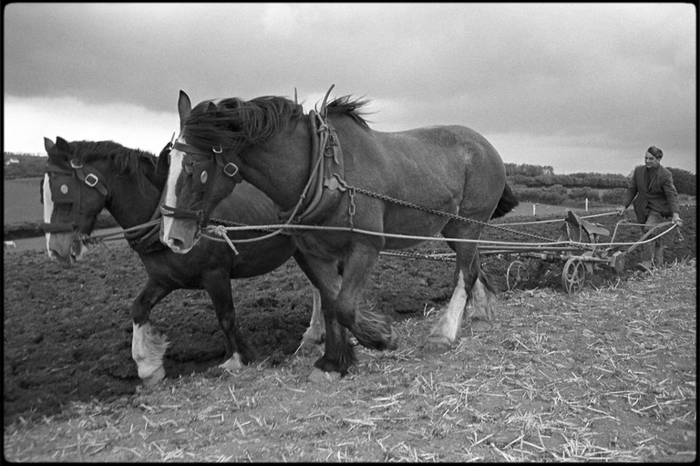

Slide 3
Drivers of Future Land Use Change
By 2030 world population expected to exceed 8.3 billion. The challenges are well known: food price spikes in 2008 and 2011-13.
Nutrition Transition;
Production of biofuels;
Pressures on key resources such as oil, water, nitrates, phosphates;
Soil degradation;
Declining growth in agricultural productivity;
Development pressure on land;

Slide 4
Demand to use land for energy production (solar, Wind, biofuels) and carbon storage;
Continued concern over biodiversity and landscape;
The new agenda of health and wellbeing;
Worries over animal and plant diseases;
Changing weather patterns linked to climate change;
Battle-lines drawn over emotional/political issues such as wildlife management and Genetic modification.

Slide 5
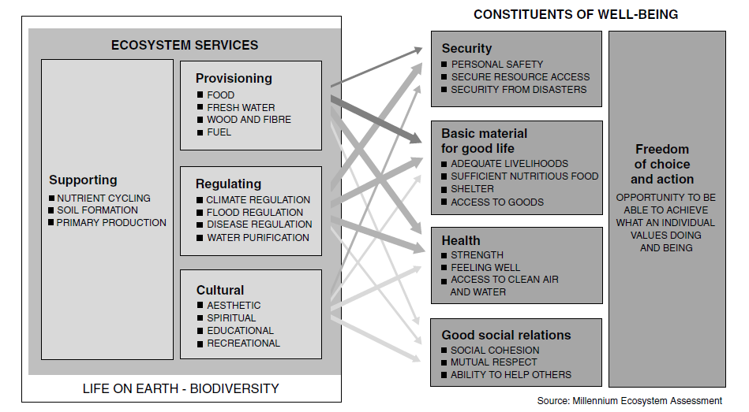

Slide 6
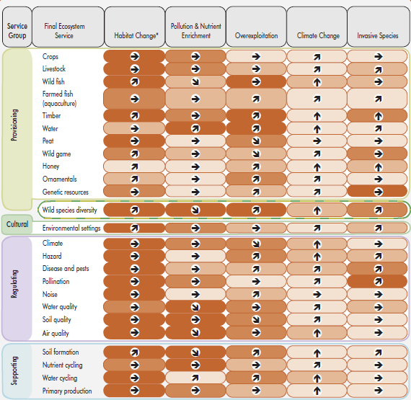
NEA, 2011: Figure 3.2 Relative importance of, and trends in, the impact of direct drivers on UK ecosystem services

Slide 7
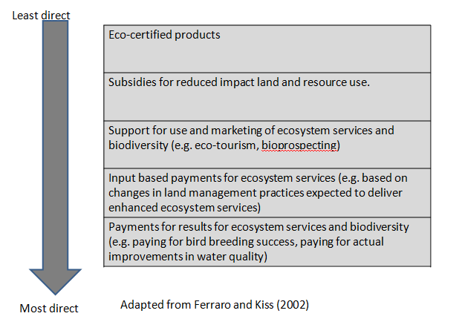

Slide 8
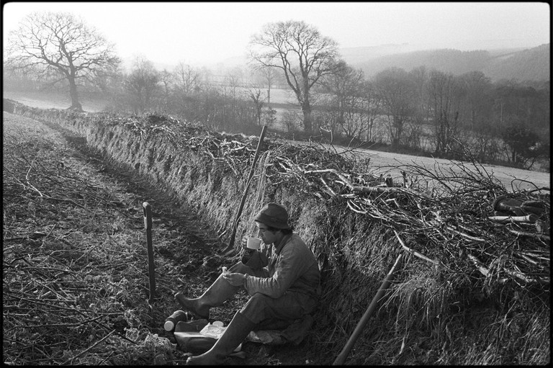

Slide 9
The danger of separate discourses:
Ecosystem services as the language for nature conservationists.
Food security as the language for agriculturalists.
Green food and sustainable agriculture require both. Agriculture is dependent on ecosystem processes and it delivers ecosystem services.
Sustainable agriculture, and therefore food security, is only possible through better understanding of agro-ecological systems and processes.
The ecosystems approach only makes sense if it prompts deliberation about all ecosystem services.

Slide 10
Five ways to Well-being: A secular rule of life?
1. Connect: With the people around you. With family, friends, colleagues and neighbours. At home, work, school or in your local community. Think of these as the cornerstones of your life and invest time in developing them. Building these connections will support and enrich you every day.
2. Be active: Go for a walk or run. Step outside. Cycle. Play a game. Garden. Dance. Exercising makes you feel good. Most importantly, discover a physical activity you enjoy and that suits your level of mobility and fitness.

Slide 11
3. Take notice: Be curious. Catch sight of the beautiful. Remark on the unusual. Notice the changing seasons. Savour the moment, whether you are walking to work, eating lunch or talking to friends. Be aware of the world around you and what you are feeling. Reflecting on your experiences will help you appreciate what matters to you.
4. Keep learning: Try something new. Rediscover an old interest. Sign up for that course. Take on a different responsibility at work. Fix a bike. Learn to play an instrument or how to cook your favourite food. Set a challenge you will enjoy achieving. Learning new things will make you more confident as well as being fun.

Slide 12
5. Give: Do something nice for a friend, or a stranger. Thank someone. Smile. Volunteer your time. Join a community group. Look out, as well as in. Seeing yourself, and your happiness, linked to the wider community can be incredibly rewarding and creates connections with the people around you.
Source: Aked, J., Marks, N., Cordon, C., & Thompson, S. (2008). Five ways to well-being: The evidence. New Economics Foundation.

Slide 13
Land, Morality, People: A Return to Stewardship
If the ecosystem services approach runs the danger of being an amoral marriage of convenience between a certain strand of economics and a certain strand of ecology, then the land management discipline has the potential to provide that added depth necessary for an ethical undertaking. Land management that makes the case for place, locality, intimacy, intricacy in our relationships with the land moves us away from narrowly utilitarian conceptions of the land.

Slide 14
We need to take stock of how we relate to land and why; to what end do we think about the land? By making that end human well-being, notwithstanding the wholly secular terms in which that paradigm has been developed, the contemporary proponents of ecosystem services offer at least a means for those who wish to reclaim the land as an ethical enterprise and a theological one. And, if grounded in that older discipline of land management, we may yet resolve some of the profound political and ethical dilemmas we confront.

Slide 15
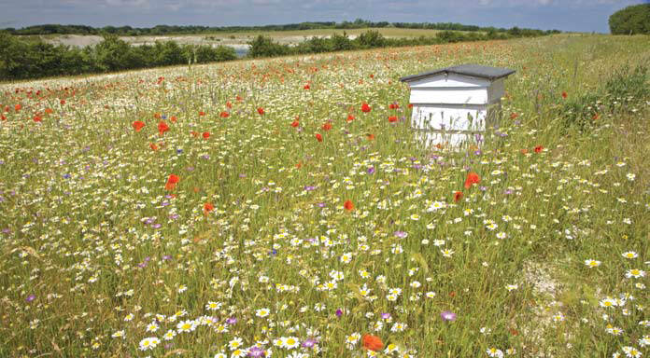
Thank you for listening

