Slide 1
A HUNGRY WORLD
A GENEROUS GOD

Slide 2
In What Sense Is God Generous?
He has provided resources that offer life that is more than survival.
    Physical resources – Land, Water Sunlight.
    Intellectual resources
      The Capacity to use resources to secure human goals
    Social resources
      The development communities that attain benefits that would be impossible in isolation.
    Spiritual resources -
      Values of self-awareness (the soul) – of love, of conscience, of self-giving, concepts of the transcendental.
      The capacity to choose

Slide 3
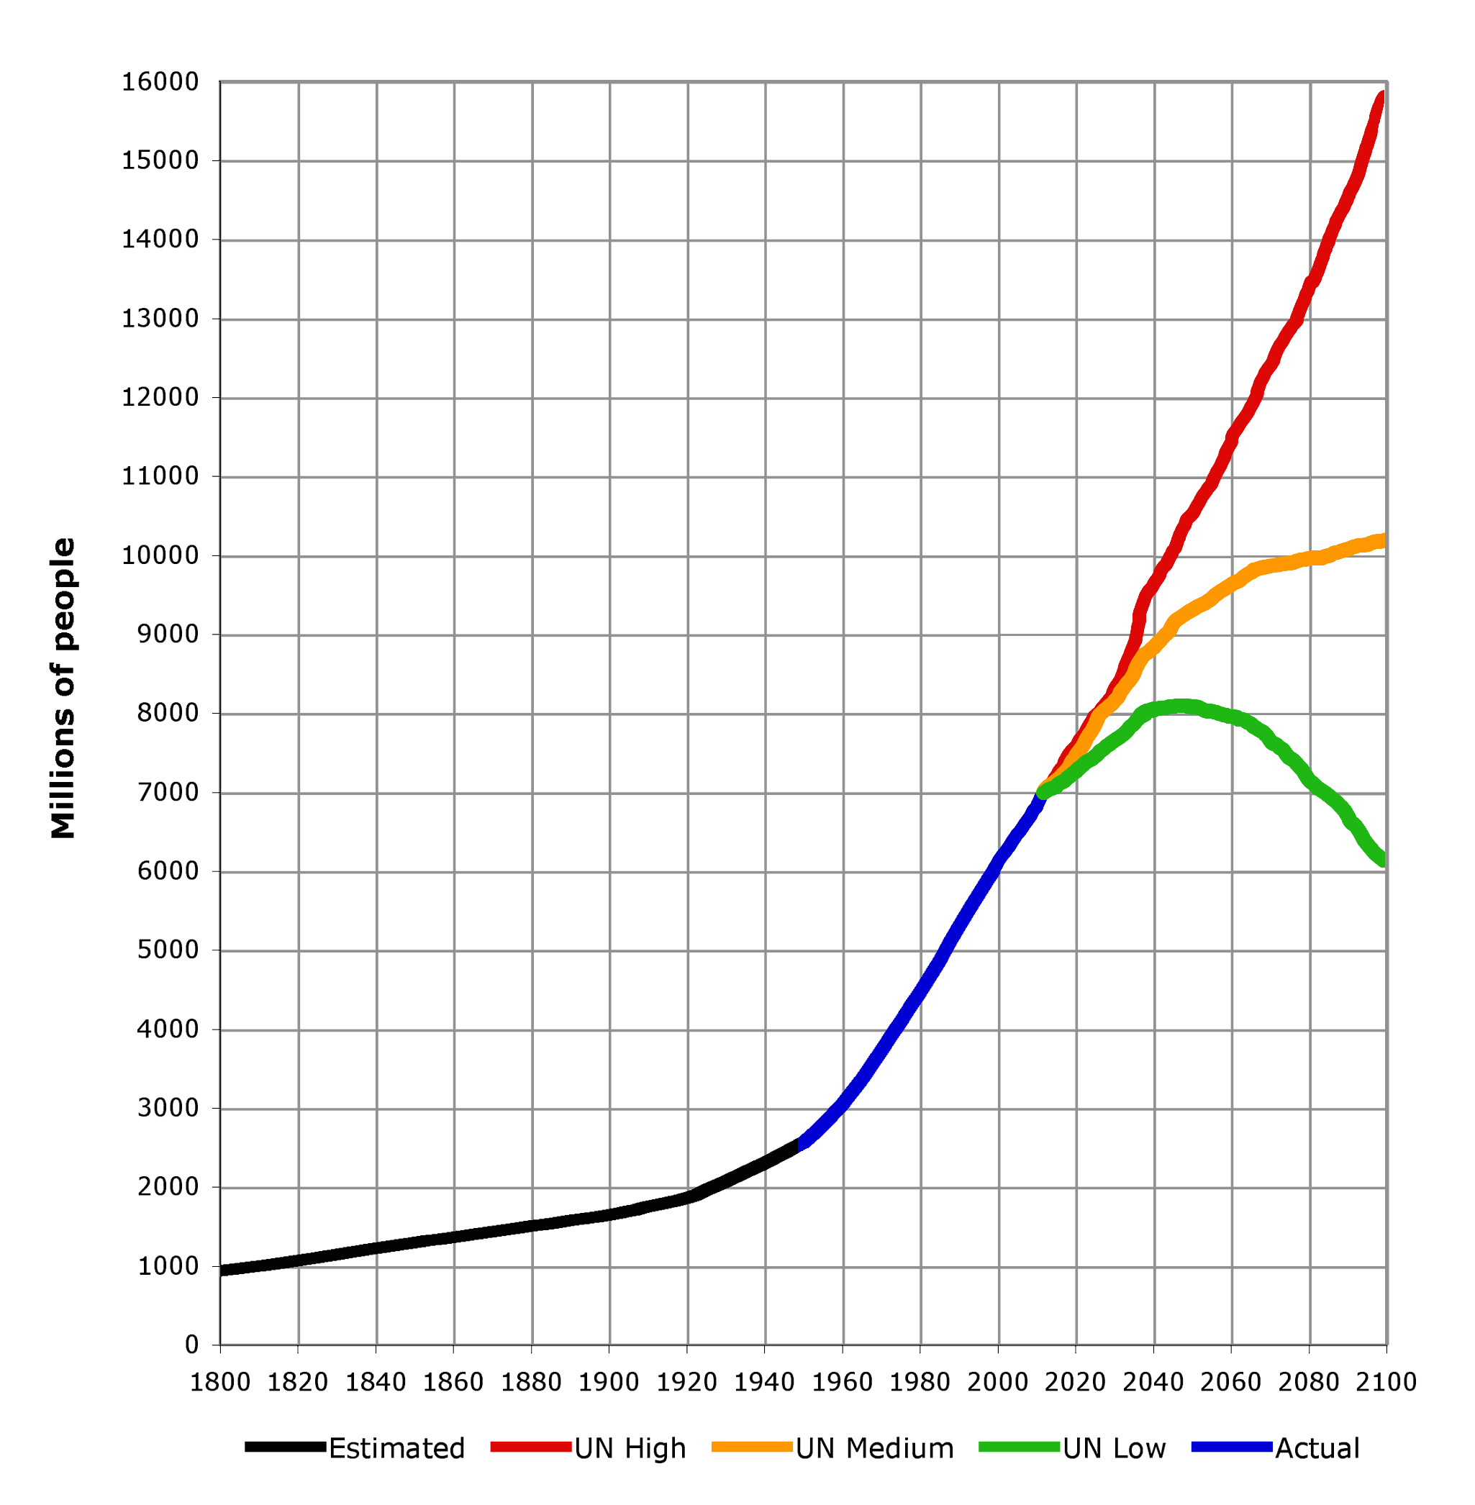
Population Has Grown

Slide 4
Population Growth Has Declined

Slide 5
Population has grown – as a result of overcoming hazards that lead to early death
  .

Slide 6
    Real incomes have risen
    People have more opportunities to choose than ever before

Slide 8
Education Of All Young People

Slide 13
Evidence of Generosity in Action
    Communities have greater capacity to serve members
      Communication
      Education – both formal and informal
      Health – based on research and social organisation to deliver benefits.
    Most people, most of the time .

Slide 14
Generous God
The Generosity of God, has been revealed where men work with God
  Left to itself ‘nature’ is not benign
  The potential of the planet has been revealed as we moved from hunting and gathering to settled farming and industrial food supply
  This has made it possible for people to live lives that are not totally absorbed in the search for nutrition.
  There is a ‘divine discontent’ in people’s wish to improve their lot.

Slide 15
A Hungry World
Hunger today
  Not just for food and material goods
  Injustice as a spiritual hunger, fosters guilt, envy and conflict
Fear of Hunger tomorrow
  Failure of stewardship – turning the garden into desert

Slide 16
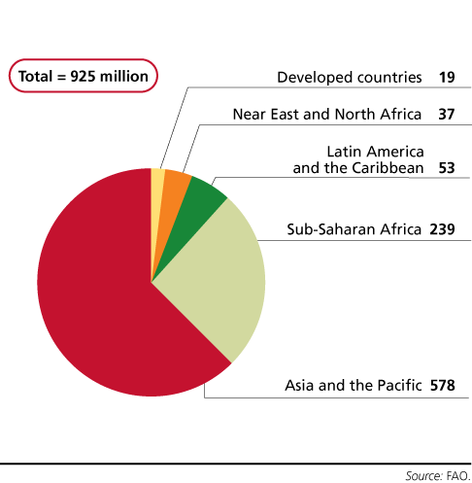
People Who are Hungry Today

Slide 17
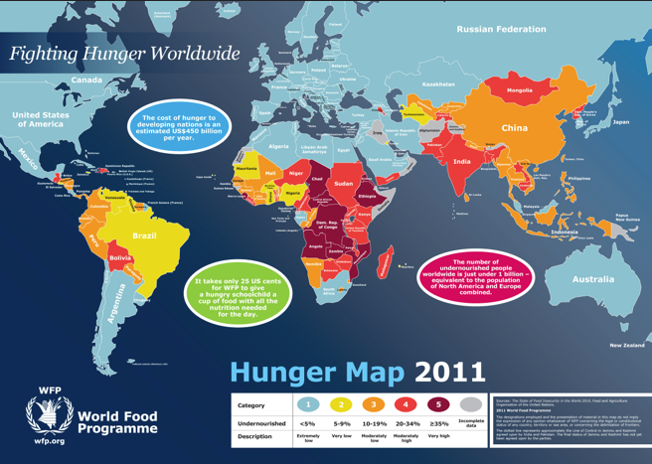

Slide 18
This happens although enough food is produced to provide for everyone.
The root cause of hunger in our present world is poverty
Producing more food will not remove hunger
People need to have entitlements
  Money Income
  Money savings
  Ownership of productive assets (Peasant Land)
  Saleable personal skills
  Private social provision – within families and local communities
  Public social provision – health, employment insurance, pensions

Slide 19
There is a huge disparity in income

Slide 20
The Poorest Remain Poor

Slide 21
It is not enough to produce more food
Economic Growth
  Growth creates incomes
  It builds an infrastructure of social provision, communication, education, health services
  It does not distribute income according to need but in relation to productivity
The Hungry need higher incomes
  Economic Growth has provided this for the well fed
  Growth in populous poor countries – China & India has an immediate impact on commodity prices
  The poorest, whose money incomes does not grow, face a cut in real income – through higher food prices.

Slide 22
What About Redistribution?
The obvious answer and one that major charities and government aid programmes seek to address but:-
  Redistribution and political acceptability
    Aid is easy when the donor economy does well– the impact of the recent recession.
  Redistribution can create dependency
    Subsidised Exports and reduced investment in recipient countries.
  Redistribution shifts the power from the market to the politically powerful
    it may be used to entrench their position rather than go to those most in need.

Slide 23
Can We Combine Growth With Justice?
Growth derives from investing rather than consuming current production
  This becomes easier as real income rises
  It is also associated with attitudes to saving, to financial institutions that enable savings to be mobilised for investment and with expectations about the future
High rates of growth in poor countries still leave their incomes in absolute terms, relatively low or lower.
  Investment by donor countries, multi-national businesses raise issues about their agenda
  Issues of political stability, corruption and infrastructure in poor countries.
  Internally growth tends to widen the gap between rich and poor

Slide 24
Agriculture
A Case Study In Market Led Growth
Markets are among the affluent, including those in foreign countries
Investment in Africa for food, flowers for sale in Europe using air transport
  Land moves from subsistence to competitive market uses.
    Money income rises but Employees buy rather than grow food
    At risk if external market collapses, if transport system becomes much more costly or trade barriers are imposed
  The rural structure changes and with it the social security provided via families may no longer exist.

Slide 25
Raising Local Output
Improving local resources
  Irrigation, Storage, Fertiliser use, Animal Breeding, Seeds.
Technological innovation
  Applying known methods to increase productivity
    Requirements for infrastructure – up and downstream of the farm
    much new technology is labour saving
    Researching appropriate technology
Raising the status of women
  Controlling family size
  Health and nutrition impacts
Education increases the capacity innovate
  But the educated look for higher incomes elsewhere – including in developed countries

Slide 26
Dealing With Hunger Today
Hunger resulting from conflict – relief for the victims
  reconciliation
Hunger because harvests fail
  Importance of information and early action
    Reluctance of countries to admit problem
    Anxiety about ‘external’ involvement
  Creation of a capacity to deliver emergency supplies
    Lack of infrastructure
    Bringing food to those most in need – children and women

Slide 27
Hunger tomorrow
Running Out of Resources
Running out of resources – finite supplies of
  Land
  Water
  Phosphates
  Fossil fuels – nitrogenous fertilisers – mechanical power
Is it possible to improve our technology at a rate that maintains affordable food within the global resource base?
  Plant and animal breeding to raise the efficiency of production
  Use of IT to relate resource use more precisely to actual demand
  Use of IT to manage resources in production – on and off the farm – more efficiently – monitoring, measuring, adjusting to changed physical or market situations.
Use IT to combat market failure
  Ensure that demand confronts the total social cost of consumption
  Shift from the most resource exhaustive patterns of provision.
  Giving a voice to the future

Slide 28
The Shape of a Sustainable System
Ensuring demand faces the real cost of provision
  This will bear most heavily on the poor
Achieving a higher level of intensity in the use of key resources
  Land, Water, Chemical’s in production and plant protection
  Higher yielding plants and animals

Slide 29
The Situation May Get Worse
Demand for crops for energy and industrial raw material already forces up the price of food
There is a fear that the methods we use to increase farming productivity will fail in the future
  Resistance to disease and pests – antibiotics, resistant weeds, narrowed genetic base of farm animals.
Climate change will not only disrupt the global economy and impede food production it may herald an unstoppable process of further climate change

Slide 30
Problems of Solutions
The reconciliation of higher intensity with other values
  Appearance of landscapes
  Animal breeding and husbandry systems
  Exposure to disease
  Role of farming in local communities
  Extended and complex supply chains – horsemeat, food safety and all that
  Hostility to gene technology

Slide 31
Killing The Goose That Lays The Golden Eggs
We are increasingly aware that our food supply depends on a complex ecological system that has been self-repairing but is threatened
  By climate change
  By loss of biodiversity
If we act irresponsibly the sustainable size of population will decline.
  Population is already controlled by mortality
  The more resources we consume per capita the smaller the number of people the world can support

Slide 32
A Human Response to a Generous God
Population has grown and living standards risen as of applying the intelligence God has given us.
We use it to get what we really want
  This has largely centred on survival
  This alone cannot achieve security or happiness
  Faced by the inescapable reality of living in a finite planet we can only survive by changing what we want
We need to focus our search to improve on different goals – to discover where our treasure really is.

Slide 33
The Generosity of God
The Currency of Love
Jesus offered no new political or economic agenda – he did promise changed lives to those who came to him in faith.
  Knowing they were loved by God
  They become free to love one another.
In him what truly matters is not survival but relationships
  Relationships that cross human barriers – that embody forgiveness and humility
  Relationships that are set not only in time but in eternity.

Slide 34
The Key Questions Are Religious.
What makes life valuable?
  If our lives are valuable in so far as they express love for God and for others, how do we give this effect?
Why do we not remove competitors?
  Hitler’s solution to the Jewish problem,
  Ethnic cleansing
  Removing the less able, mentally or physically
Why do we have responsibility towards future generations?

Slide 35
Loving Our Neighbour
Working within the possible – imposed solutions will not work
Enlarging what is possible by shared understanding of the implication of choices
  Both material and social
Moving from maximising consumption to maximum service
Delighting in values that are eternal and universal rather than temporal and individual.

